Slide 1

Data Acquisition, Storage, and Linkage
Rayid Ghani and Kit Rodolfa

Slide 2
Short Quiz on Lecture Video

Slide 3
Weekly Review Feedback
The weekly review forms are a forum for you to provide feedback about what you’re learning and how the class is going
Some common themes from last week:
Class discussions
Getting set up with the course technology
Finding course materials/announcements

Slide 4


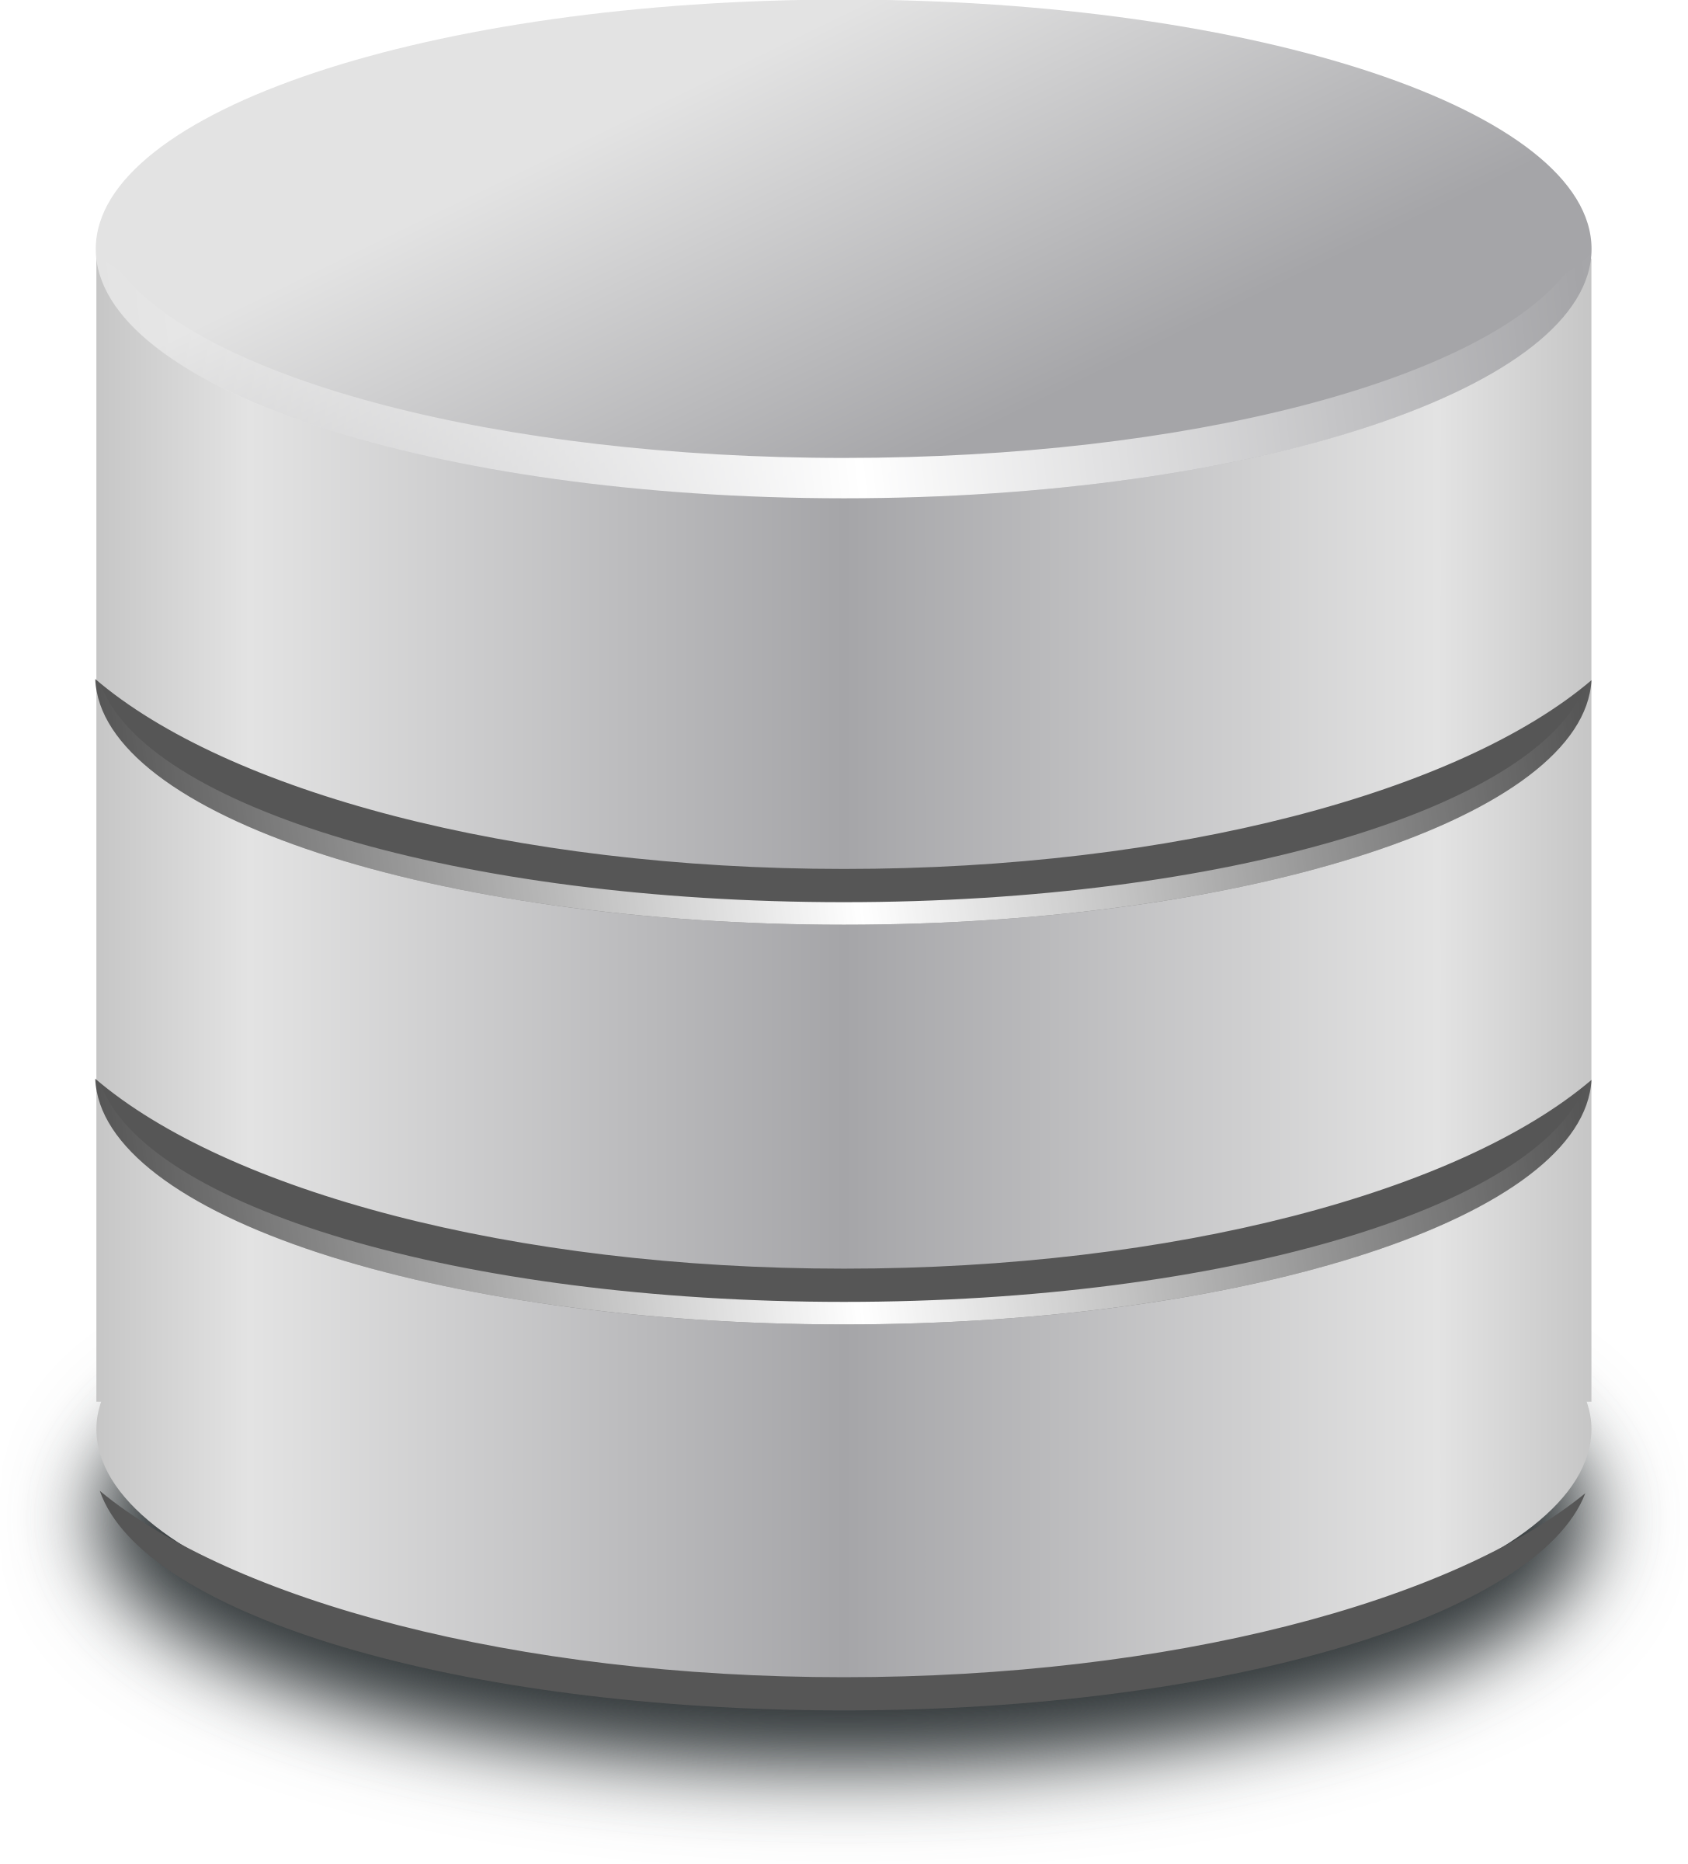



Class Infrastructure Elements
GitHub Server
Your Laptop
Class Server
Class Database
VPN

Slide 5
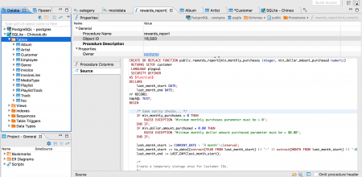
Class Infrastructure: Using dbeaver
SSH Tunnel
dbeaver Client
VPN

Slide 6
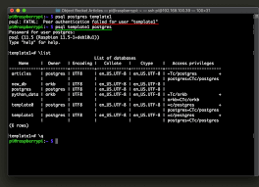
Class Infrastructure: Using Jupyter
psql Client
VPN

Slide 7


Class Infrastructure: Using Jupyter
SSH Tunnel +
Jupyter Server
Browser
VPN

Slide 8
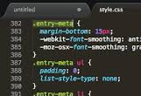
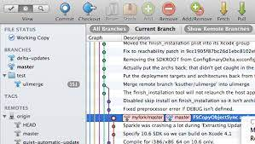
Class Infrastructure: Editing Code (local editor)
Git CLI
Text
Editor
Git
Client

Slide 9
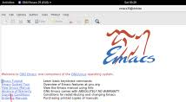
Class Infrastructure: Editing Code (remote editor)
Git CLI +
Text Editor
VPN

Slide 10
Things to remember
We’ll finish setting up your project teams by tomorrow (Friday)
Make sure and check that you can access your project data before class on Tuesday
What’s coming next week:
Assignment
Weekly review
ACS Data loading
Readings
Make sure to read project proposal preparation guidelines

Slide 11
Scope
Data
Exploration
Modeling
Get Data
Store Data
Link Data
Rows
Features
Labels
Model Selection
Train-Test Splits
Performance Metrics
Model Interpretation
Entities
temporal
Spatial
…
Models
Dealing with Bias and Fairness
Field Trial Design
Deployment
Monitoring
Goals, Actions, Data, Analysis, Ethics

Slide 12
Plan for today
We covered the conceptual material about acquiring data & record linkage in the video you watched before class. So we’ll spend this session discussing:
Working together with your project team
Bias and fairness considerations with record linkage
Your experiences with acquiring data for projects

Slide 13
Working with Your Project Team
Teams designed to balance skills, backgrounds, and experiences
Everyone should participate in all aspects of project
No individual should do the majority of the python coding, SQL writing, report writing
However, you should divide up different pieces of the work
For instance, working on different parts of the pipeline code in parallel or splitting up sections of the report

Slide 14
Working with Your Project Team
We’re providing class time to make it easier to coordinate with your group and get feedback from peers and instructors, but you won’t be able to complete the project just in this allotted time
Tools for coordination:
Slack: we’ve created group-level and project-level channels. Additionally, feel free to use group DMs and video calls with your group to coordinate as well.
Many good free options for task tracking/management: github issues or project boards, trello, etc.

Slide 15
Working with Your Project Team
Active participation in the group work throughout the entire semester is required by all the team members, and a very large component of your grade
Collaboration is encouraged, both within and across teams! Learning from each others’ strengths is a big benefit of group work, and you should feel free to discuss strategies and approaches with other teams (i.e., it’s not a competition)
Pacing your work is important. You won’t be able to do everything the week before the final report, and if everyone tries to, you’ll break the server.

Slide 16
DISCUSSION QUESTION
Past experiences with project groups or questions/feedback about this semester?

Slide 17
DISCUSSION QUESTION
What are some experiences
and challenges you’ve
encountered with acquiring data
(for research, consulting, etc)?

Slide 18
DISCUSSION QUESTION
How could record linkage choices and methods impact bias and fairness?

Slide 19
Things to remember
We’ll finish setting up your project teams by tomorrow (Friday)
Make sure and check that you can access your project data before class on Tuesday
What’s coming next week:
Assignment
Weekly review
ACS Data loading
Readings
Make sure to read project proposal preparation guidelines

